Slide 1
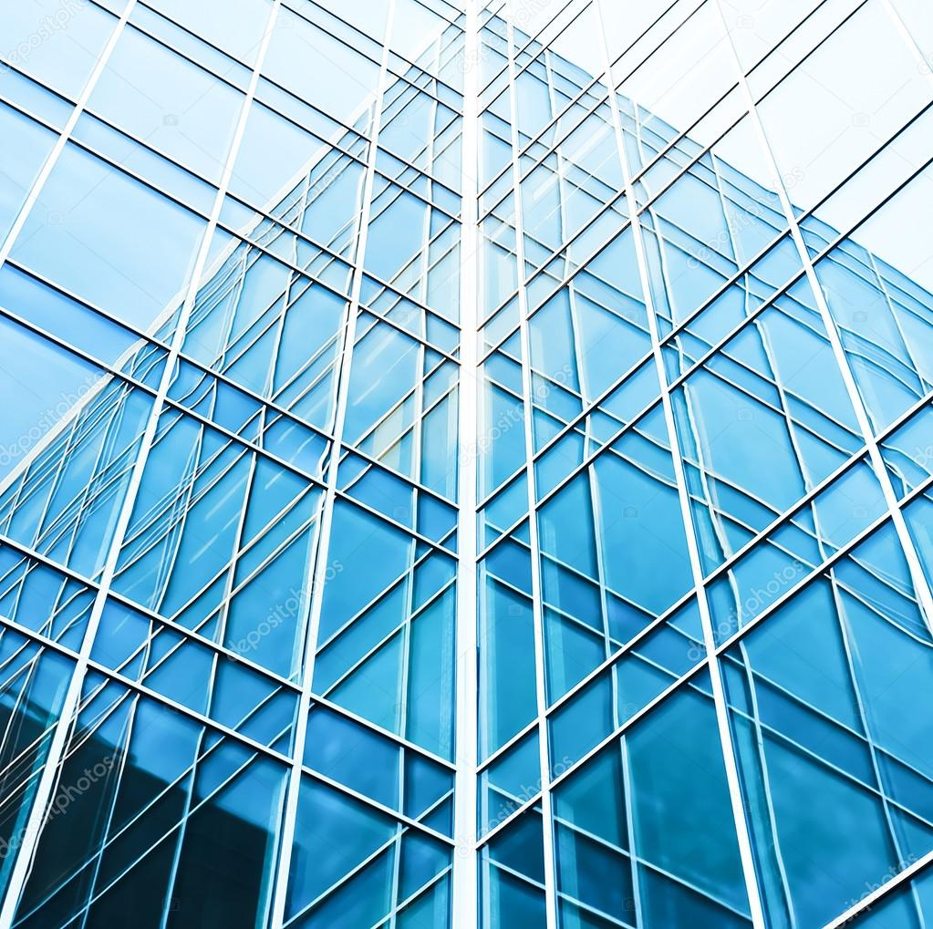
Glass Classification using KNN
Shruti Houji - 405203
Rhishabh Hattarki - 405204
Sahil Dixit - 405205
Sanika Patil - 405206

Slide 2







INDEX
INTRODUCTION
MOTIVATION
PROBLEM STATEMENT
OBJECTIVE
DATA DESCRIPTION
DATA PREPROCESSING
METHODOLOGY
SOFTWARE REQUIREMENT
DIAGRAMS & IDEA MATRIX
APPLICATION
CONCLUSION

Slide 3
Introduction
Glass is a non- crystalline, amorphous solid that is most often transparent and has widespread practical, technological and decorative uses in for example window panes
Glass companies and factories that use glass as raw material can have difficulty understanding and classifying glass materials.
Different properties of glass such as refractive index and its various constituents are taken into account for glass classification

Slide 4
Motivation
The main issue: it is hard to determine the category of the glass which can answer what sort of glass is suitable for what purpose scientifically
To the type of glass in which the data points are separated into several classes to predict the classification.
To test different models using methods such as unit testing and functional testing have shown capable methods of testing.

Slide 5
Problem Definition
To derive rules to classify the glass into its suitable types using KNN classification algorithm and use K means clustering .
We also intend to perform unit testing and selenium testing on our model

Slide 6




Objectives
To understand the important characteristics
To analyze which attributes affect the category of glass
To predict the category of glass from its attributes
Minimize the efforts of glass makers and sellers

Slide 7
Data Description
The dataset contains 10 columns defining different attributes affecting the category of the glass
The dataset has 7 types of possible outputs
Some of the prominent attributes are listed in the next slide

Slide 8
Dataset Attributes
RI :Refractive index
Na :Sodium
Mg :Magnesium
Al :Aluminum
Si :Silicon
K :Potassium
Ca :calcium
Ba :Barium
Fe :Iron
Type of glass

Slide 9
Data Preprocessing
Oversampling
Oversampling in data analysis are techniques used to adjust the class distribution of a data set used both in statistical sampling, survey design methodology and in machine learning
We preprocessed our skewed data to modify unequal rows to create balanced data sets
The problem is that the dataset is skewed towards Type = 1 and Type = 2. This skewness can reduce the accuracy of the model. Basically, the values of the types with relatively lesser rows is increased

Slide 10
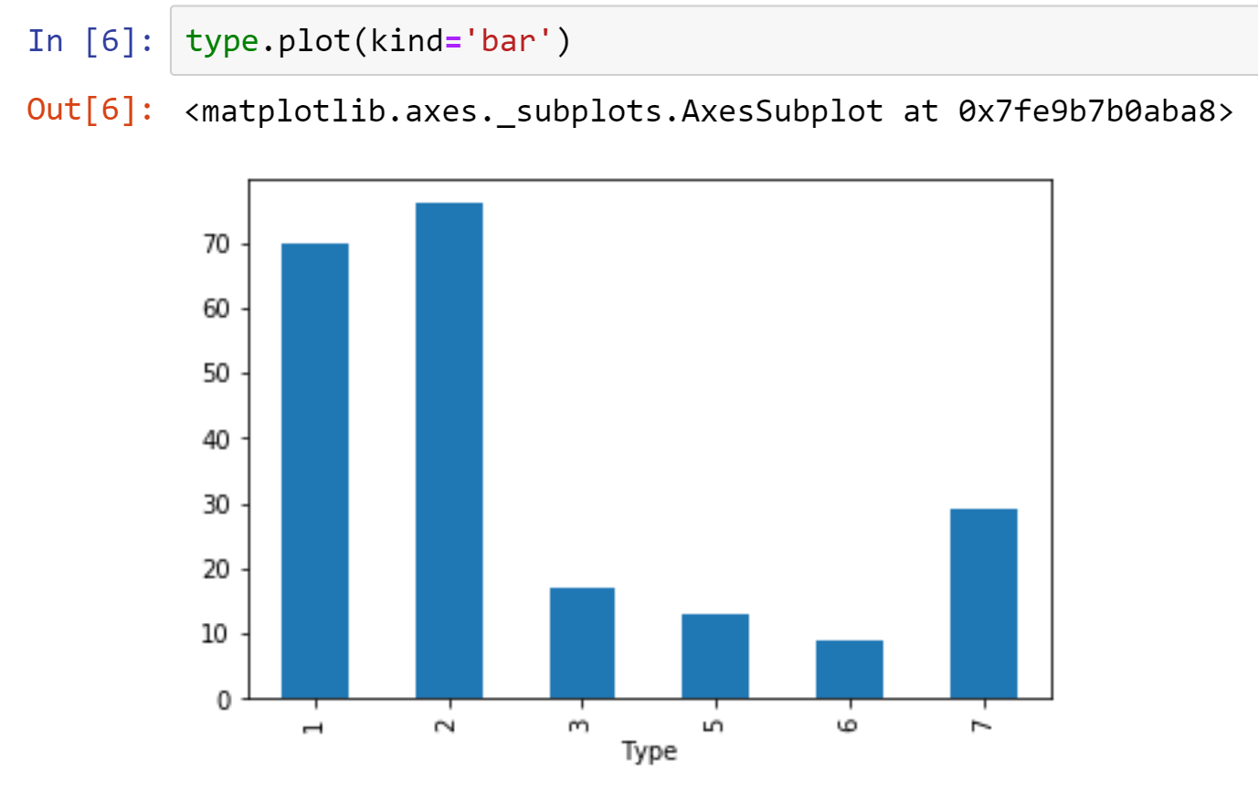
Before oversampling

Slide 11
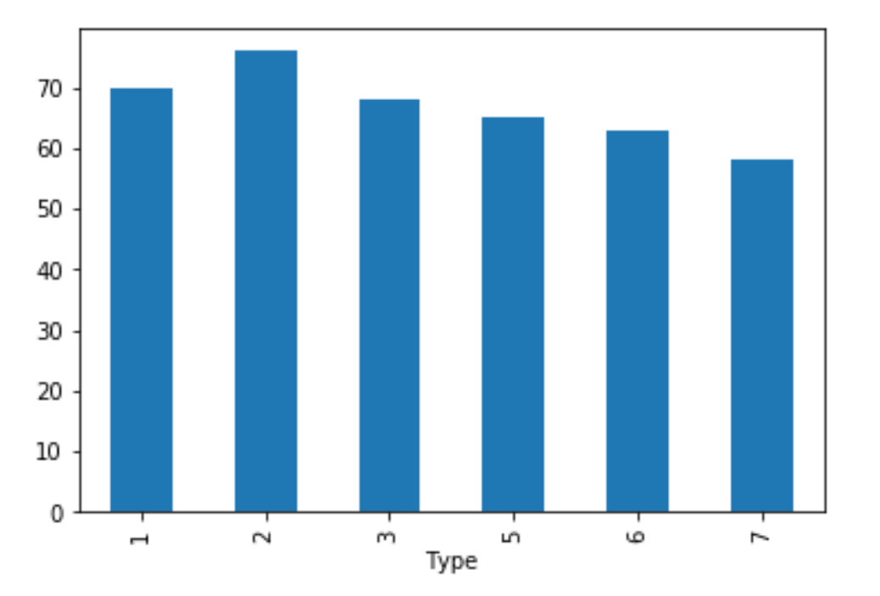
After oversampling

Slide 12
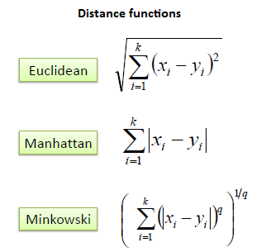
KNN
KNN is a non-parametric, lazy learning algorithm. Its purpose is to use a database in which the data points are separated into several classes to predict the classification of a new sample point.

Slide 13
K – Means Clustering
•K-means clustering is one of the simplest and popular unsupervised machine learning algorithms.
•Typically, unsupervised algorithms make inferences from datasets using only input vectors without referring to known, or labelled, outcomes.
•A cluster refers to a collection of data points aggregated together because of certain similarities.
•K-means algorithm identifies k number of centroids, and then allocates every data point to the nearest cluster, while keeping the centroids as small as possible.
•The ‘means’ in the K-means refers to averaging of the data; that is, finding the centroid.

Slide 14
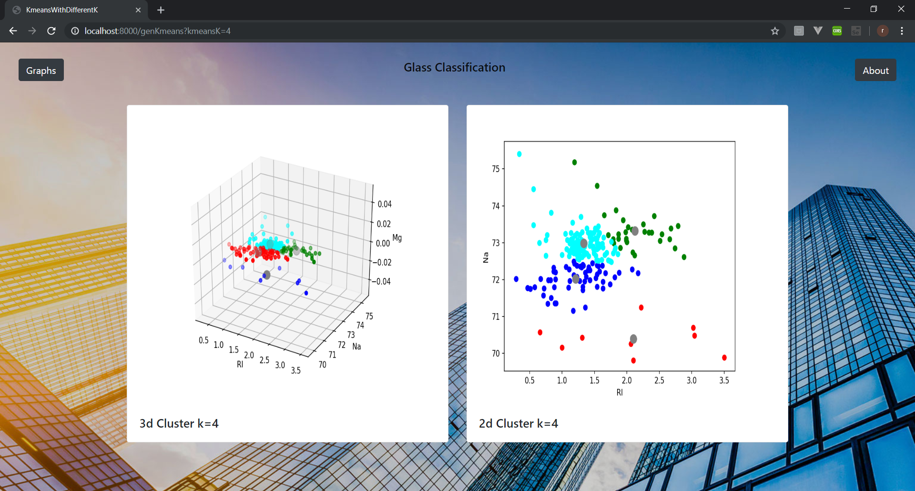
K-Means
K-Means

Slide 15

Unit Testing
We have tested the following five units using "unittest" library:
Accuracy function check
Euclidean distance function check
Manhattan distance function check
Minkowski distance function check
Predict function check

Slide 16
Sr.No | Function Name | Input | Expected Output | Observed Output | Result
1 | predict() | [[1.51514,14.85,0,2.42,73.72,0,8.39,0.56,0]] | 7 | 7 | Pass
2 | accur() | Numeric values of row no 209 from dataset | >0.8 | 0.83644 | Pass
3 | manhattan() | [[ 1.51655, 12.75 , 2.85 , 1.44 , 73.27 , 0.57 ,8.79 , 0.11 ,0.22 ]] | [[5.24446, 3.89106, 3.38037,…]] | [[5.24446, 3.89106, 3.38037,…]] | Pass
4 | euclidean() | [[ 1.51655, 12.75 , 2.85 , 1.44 , 73.27 , 0.57 ,8.79 ,0.11 ,0.22 ]] | [[2.47782564, 1.77490876, 1.51650919,…]] | [[2.47782564, 1.77490876, 1.51650919,…]] | Pass
5 | minkowski() | [[ 1.51655, 12.75 , 2.85 , 1.44 , 73.27 , 0.57 ,8.79 , 0.11 ,0.22 ]] | [[5.24446, 3.89106, 3.38037,…]] | [[5.24446, 3.89106, 3.38037,…]] | Pass

Slide 17
Selenium Testing
Test Item | Test Steps | Result
Page linking | 1. Open website 2. Locate graph button, click 3. Locate graph button, click 4. Locate glass heading button, click 5. Locate graph button, click 6. Locate about button, click 7. Locate graph button, click 8. Locate kmeans ip box 9. Send k value 10. Click on gen kmeans but 11. Locate home but, click | User should navigate to and fro the home page , graphs page and about page
Home page form | 1.Locate input box 2.Add random float value 3.Repeat for all boxes 4.Submit form | Fill home page form, submit it, get classification report
Selenium is an open source tool which is used for automating the tests carried out on web browsers (Web applications are tested using any web browser).

Slide 18
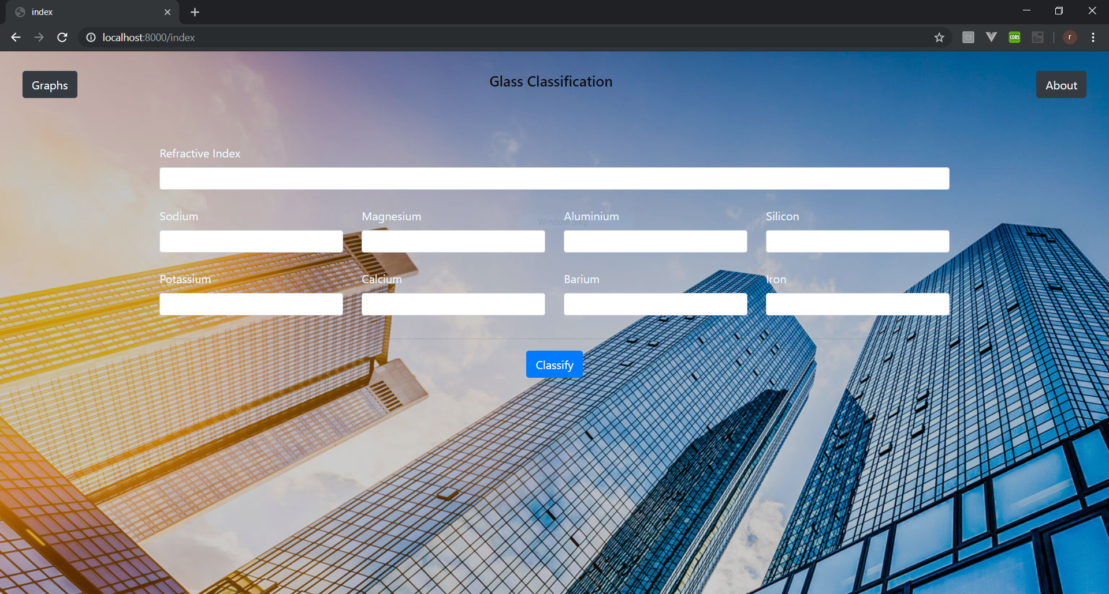
HOME PAGE
Home Page

Slide 19
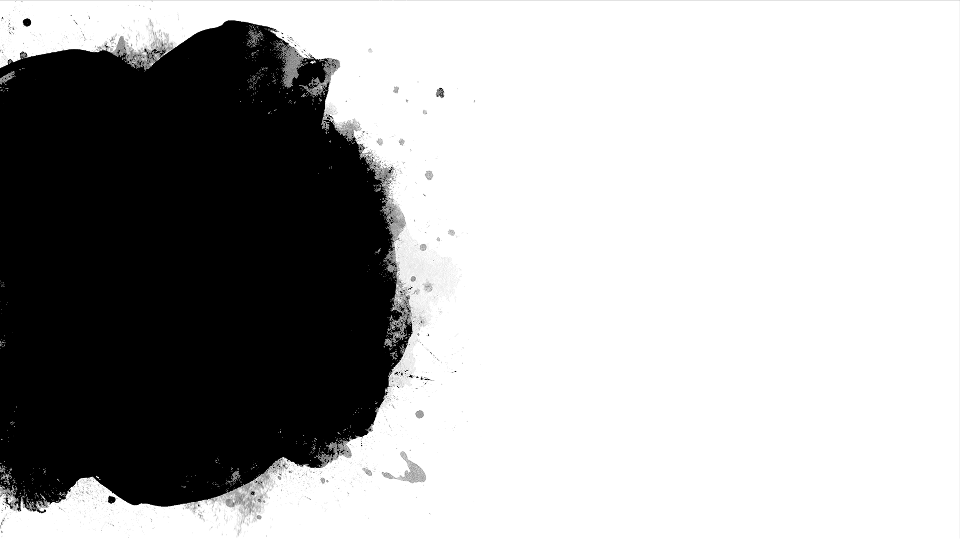
Software Requirements
Details of software:
Django
Visual Studios Code
Selenium
unittest
Libraries and packages:
Pandas
Sklearn
Numpy
unittest

Slide 20
Idea matrix ‘I’
IDEA | Deliverable | Parameter Affected
Increase | It increases Glass Quality | Glass Contents
Improve | It improves the identification of glass type Improves awareness of customer about glass type | Chemical Contents User awareness
Ignore | It ignores the physical appearance of the glass. | No parameter is affected.

Slide 21
IDEA | Deliverable | Parameter Affected
Deliver | It delivers specific class types to specific customers | Customers
Document | Documentation of the project for researchers to understand and improve on the project in the future. | Project documentation
Decrease | It decreases efforts and time taken to classify the types | Effort
Idea matrix
‘D’

Slide 22
IDEA | Deliverable | Parameter Affected
Educate | Educate user with knowledge of type of glass Educate project members with –machine learning(knn, kmeans), selenium, unittest | User Project members
Evaluate | Evaluate weight percent in corresponding oxide from user to classify type of glass. Evaluate efficiency of algorithms to create the best model | User Input, output Efficiency of algorithms
Experiment | Experiment on different types of ML models Experiment on different distance metrics like Euclidean, Manhattan, Minkowski | ML models Distance Metrics
Idea matrix
‘E’

Slide 23
IDEA | Deliverable | Parameter Affected
Accelerate | Accelerates the process of classifying the glasses according to its properties | Execution speed of the process in the factory/company
Analysis | It analyses the data using K-means clustering and forms a visual representation of the clusters. | Understanding and knowledge of the dataset
Actualize | Implementation of the system using the dataset | Project model
Idea matrix
‘A’

Slide 24
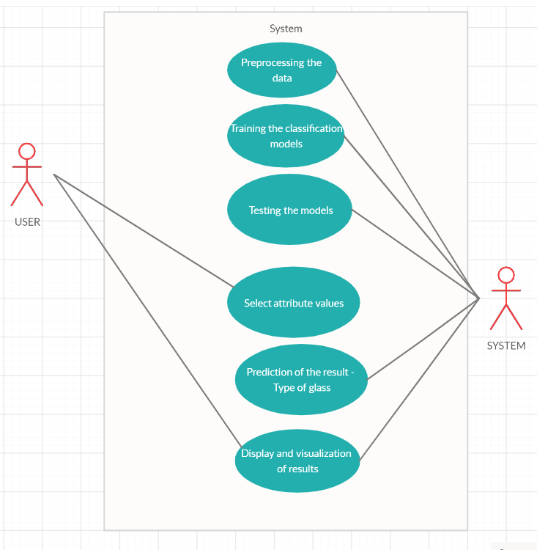
USE CASE DIAGRAM

Slide 25
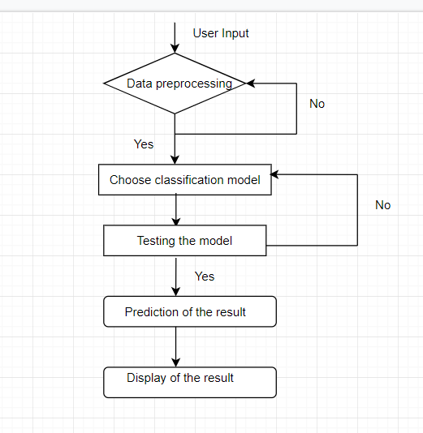
ACTIVITY DIAGRAM

Slide 26
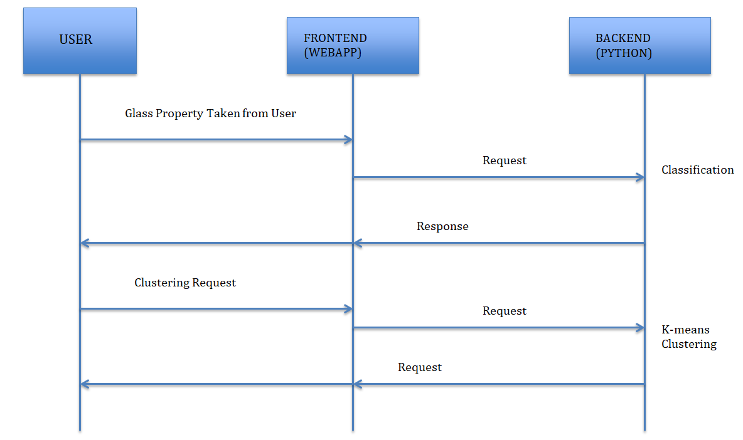
SEQUENCE DIAGRAM

Slide 27




Application
Interior design and furniture
Fiber optic cables(phones, TV ,computers: to carry information)
Biotechnology
Automobile and transport

Slide 28
Conclusion
•We have created a system that can take input from the user about various attributes which are basically properties of the glass. These readings are then successfully classified according to the various categories of the glass.
•Testing is performed which makes sure that the expected and actual results are a match for every single module. Different types such as unit testing, functional testing etc. are performed to make the project defect-free.
•As a concluding point, given the values of the attributes, the algorithm has been trained to correctly predict the type of glass..

Slide 29
ANY QUESTIONS?

Slide 30
References
https://archive.ics.uci.edu/ml/datasets/Glass+Identification
https://www.kaggle.com/yundoou/knn-precision-rate-grows-from-72-to-92/data
https://sites.google.com/site/dataclusteringalgorithms/k-means-clustering-algorithm
https://www.glassallianceeurope.eu/en/applications
https://www.schaeferglas.com/news/classification-glass/

Slide 31
THANK YOU!

